Slide 1

Title of the Project : ELECRTIC MOTOR TEMPERATURE PREDICTION
Project Supervisor : DR.S.JAYANTHI
Name of the Student : LINGAMPALLI BHARATH SAI
Register Number : 40110674

Slide 2

Course Certificate

Slide 3
Introduction
The main purpose of the data set's recording is to be able to model the stator and rotor temperatures of a PMSM in real-time. Due to the intricate structure of an electric traction drive, direct measurement with thermal sensors is not possible for rotor temperatures, and even in case of the stator temperatures, sensor outage or even just deterioration can't be administered properly without redundant modeling. In addition, precise thermal modeling gets more and more important with the rising relevance of functional safety

Slide 4
Objective :
This project aims to estimate temperature sequences inside Permanent Magnet Synchronous Motors(PMSM) from given input sequences, that is, currents, voltages, coolant and ambient temperatures, and torque as well as motor speed. All sensor data is deployed on a test bench.

Slide 5
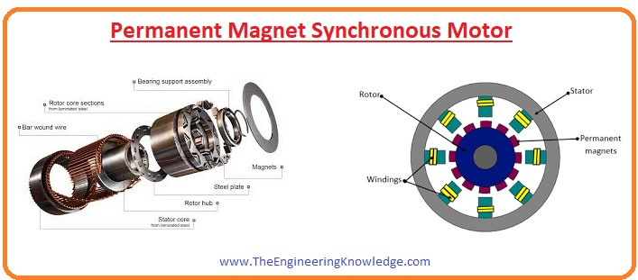
System Architecture/ Ideation Map
Temperature is an important factor to control in motor components
High temperatures can melt stator windings and demagnetise permanent magnets
Complicated internal structure of the motor discourage sensors based monitoring
11 November 2021
Department of CSE
5

Slide 6

This is a typical stator winding damage :
On the rotor part, irreversible demagnetization of the permanent magnets can be caused by overheating, which represents an even more severe instance of motor damage.

Slide 7
Project Implementation Project flow:
Data cleansing
Duplicate values removal
Missing values treatment
EDA
Outlier treatment
Feature Engineering
Data pre processing
Data type conversion
Normalization/ Standardization
Data visualisation
Model building
Regression model
Tree model
Model evaluation
Evaluating using RMSE metric
Model deployment

Slide 8
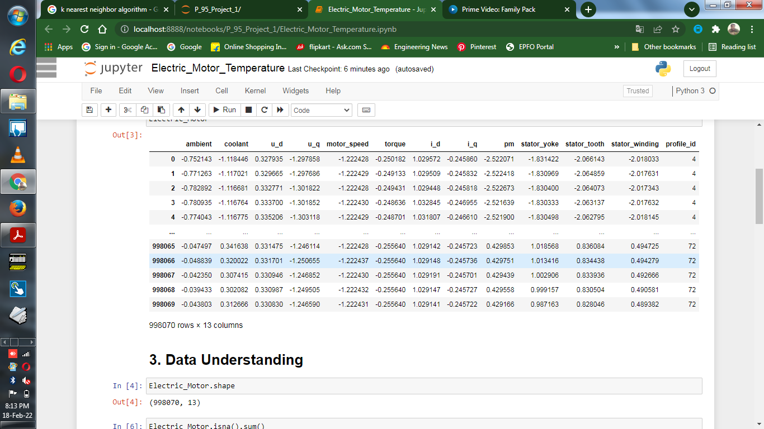
Data set details
Data set: Temperature data of electric motor
998070 Observations & 13 features
Motor speed has 490798 unique vales
There is no null values in the entire data sets
Profile_Id has 52 unique values

Slide 9
Exploratory Data Analysis (EDA)
After converting into factor we will get 52 levels.
Now find the correlation ship between the variables. There is a collinearity also.
Now we have to make the profile_id into unique, by doing this we will come to know how many levels are there.
The data set will follow normality.
When we used scatterplot we came to know about linearity. Data set follows positive linearity.
Histogram and bar plot will help us to find the variation in the data set.
Heat plot will tell us whether there are any NA values and correlation of the variables.
There are outliers in the data set. Before performing model building we have to treat the outliers..

Slide 10
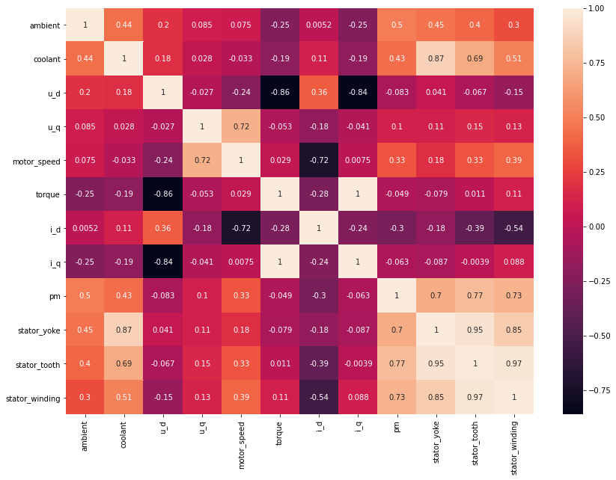
SAMPLE SNAPSHOTS
Exploratory Data Analysis (EDA)
Highly Correlated Features:
Coolant & Stator_yoke
Torque & i_q
i_q & Torque
pm & Stator_winding
Staor_yoke & Stator_tooth
Stator_tooth & Stator_winding
Stator_winding & Stator_tooth

Slide 11
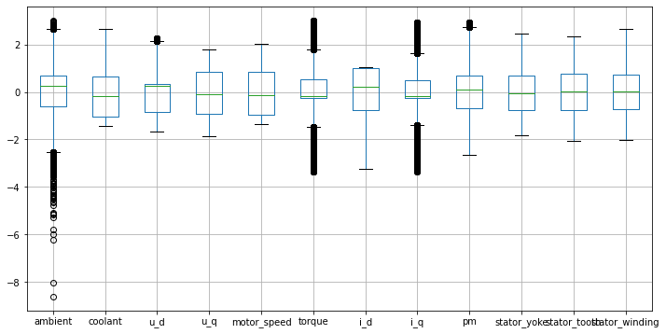
Exploratory Data Analysis (EDA)
Outliers:
Ambient
u_d
Torque
i_q
pm
Outliers are removed Using IQR Technique

Slide 12
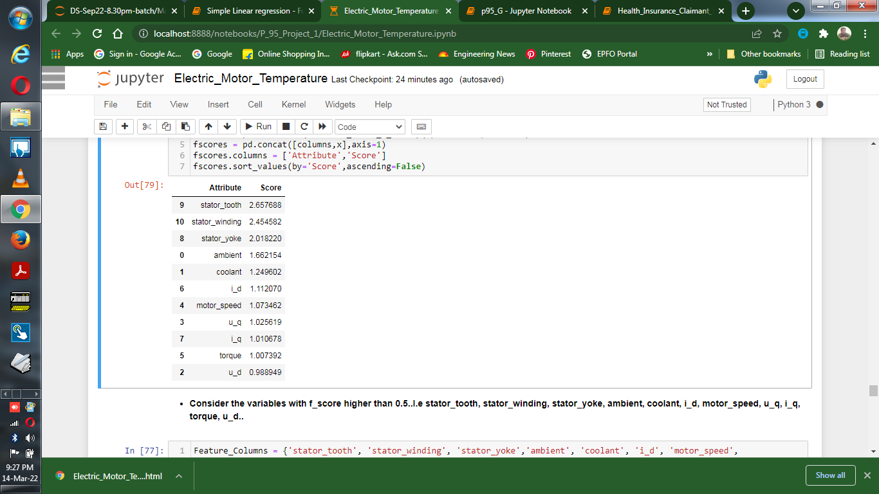
Feature Engineering
Feature Selection Technique:
Consider the variables with f_score higher than 0.5.
stator_tooth, stator_winding, stator_yoke, ambient, coolant, i_d,
motor_speed, u_q, i_q, torque, u_d.
Considered all the features as values are more than 0.5

Slide 13
Model Building
In this project, We investigate the usage of different models to predict the output
temperature
Regressor Models
Linear Regressor
K_Nearest Neighbour s Regressor
XG_Boosting Regressor
Ada_Boosting Regressor
Random Forest Regressor
Decision Tree Regressor

Slide 14
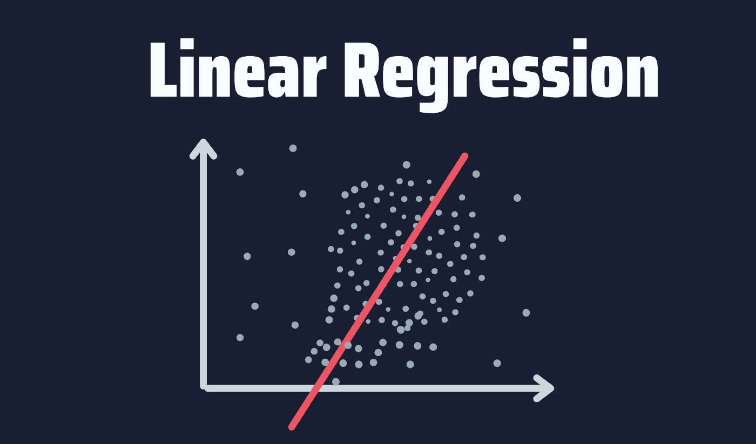
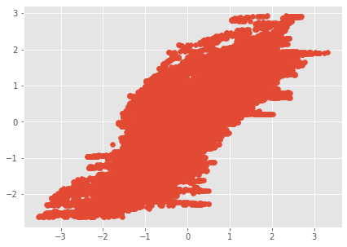
1. Linear Regressor Model
Linear Regression is a supervised machine learning algorithm where the predicted output is continuous and has a constant slope. It's used to predict values within a continuous range
Train Accuracy : 77.20002736974052
Test Accuracy : 77.2865856222581
Accuracy : 77.2865856222581
RMSE : 0.477019305740762
MAE : 0.36319074962992165

Slide 15
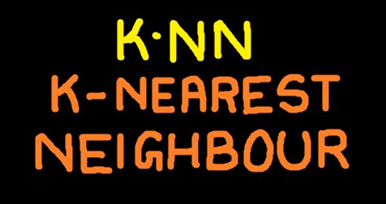
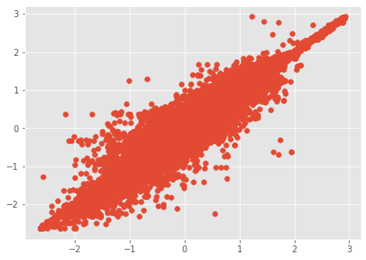
2. KNN Regressor Model
Implementation of KNN regression is to calculate the average of the numerical target of the K nearest neighbors. Another approach uses an inverse distance weighted average of the K nearest neighbors. KNN regression uses the same distance functions as KNN classification
Train Accuracy : 99.25082110735671
Test Accuracy : 98.99361645443634
Accuracy : 98.99361645443634
RMSE : 0.1002711612245651
MAE : 0.03393914566552563

Slide 16

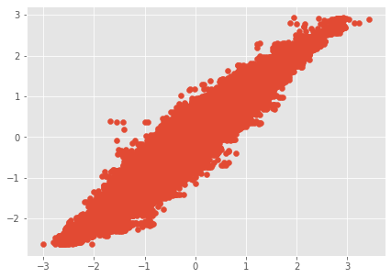
3. XG_Boosting Regressor Model
XGBoost is an efficient implementation of gradient boosting that can be used for regression predictive modeling.
Train Accuracy : 96.80005738617857
Test Accuracy : 96.68480926514954
Accuracy : 96.68480926514954
RMSE : 0.1819904256500817
MAE : 0.1282162559270821

Slide 17

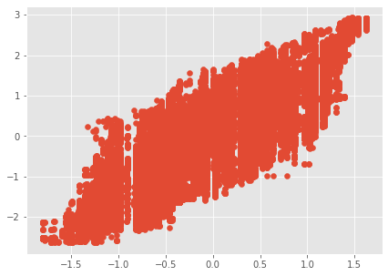
4. Ada_Boosting Regressor Model
An AdaBoost regressor. An AdaBoost regressor is a meta-estimator that begins by fitting a regressor on the original dataset and then fits additional copies of the regressor on the same dataset but where the weights of instances are adjusted according to the error of the current prediction.
Train Accuracy : 69.14297352452014
Test Accuracy : 69.08893732419581
Accuracy : 69.08893732419581
RMSE : 0.5557138855929603
MAE : 0.4545678955507581

Slide 18

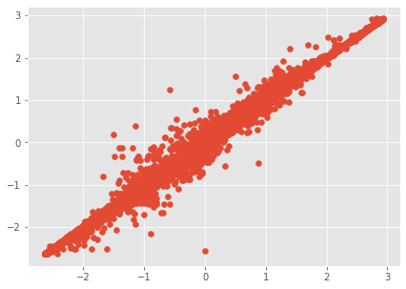
5. Random Forest Regressor Model
Random Forest Regression is a supervised learning algorithm that uses ensemble learning method for regression. Ensemble learning method is a technique that combines predictions from multiple machine learning algorithms to make a more accurate prediction than a single model
Train Accuracy : 99.98630124207375
Test Accuracy : 99.91253332429235
Accuracy : 99.91253332429235
RMSE : 0.029560759708905922
MAE : 0.008142496245745994

Slide 19

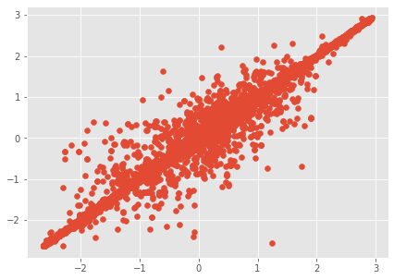
6. Decision Tree Model
Decision tree builds regression or classification models in the form of a tree structure. It breaks down a dataset into smaller and smaller subsets while at the same time an associated decision tree is incrementally developed. Decision trees can handle both categorical and numerical data
Train Accuracy : 100.0
Test Accuracy : 99.74606875523865
Accuracy : 99.74606875523865
RMSE : 0.05036772689905369
MAE : 0.007917195580808811

Slide 20
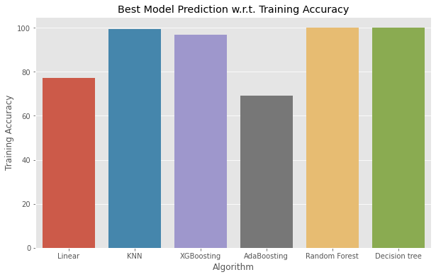
Algorithm Vs Training Accuracy

Slide 21

Algorithm Vs Testing Accuracy

Slide 22
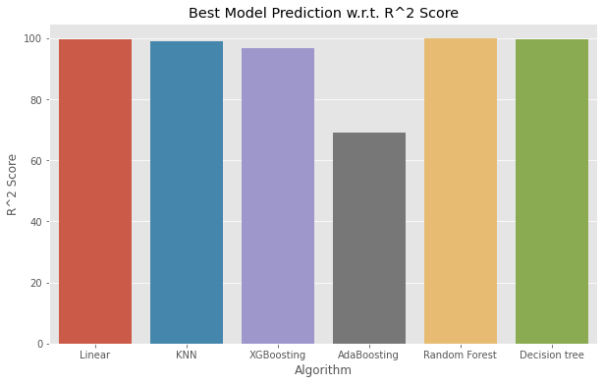
Algorithm Vs R^2 Score

Slide 23
Results and Discussion
From the above all regressor model we got the best test and train accuracy in the random forest regressor model.
So we choose random forest regressor model for the model deployment.

Slide 24
Conclusion
This study focuses on using exploratory data analysis (EDA) and predictive models to estimate permanent magnet motor temperature. The first task focuses on the distribution of each attribute and their relationships to one another from EDA.
It is shown that with careful feature selection and feature engineering, it is possible to precisely predict motor temperatures with different machine learning tools.

Slide 25
References
AA, ACBK (2021) Optimal solution for PMSM rotor magnet demagnetization based on temperature estimation for EV application
Data Science from Scratch : First Principles with python by Joel Grus

Slide 26
THANK YOU

